Slide 1
Basic Position Description Generation
DHS PushButtonPD™

Slide 2
Welcome
Welcome and thank you for using the DHS PushButtonPD™ -
The following slides contain the basic steps needed to generate a position description.
If you are unsure of what content is most appropriate for your position(s) or need further assistance, please contact your servicing Human Capital office.
Again, many thanks and please let us know if we can be of further service.

Slide 3
Basic PD Generation
Steps 1 through 7

Slide 4
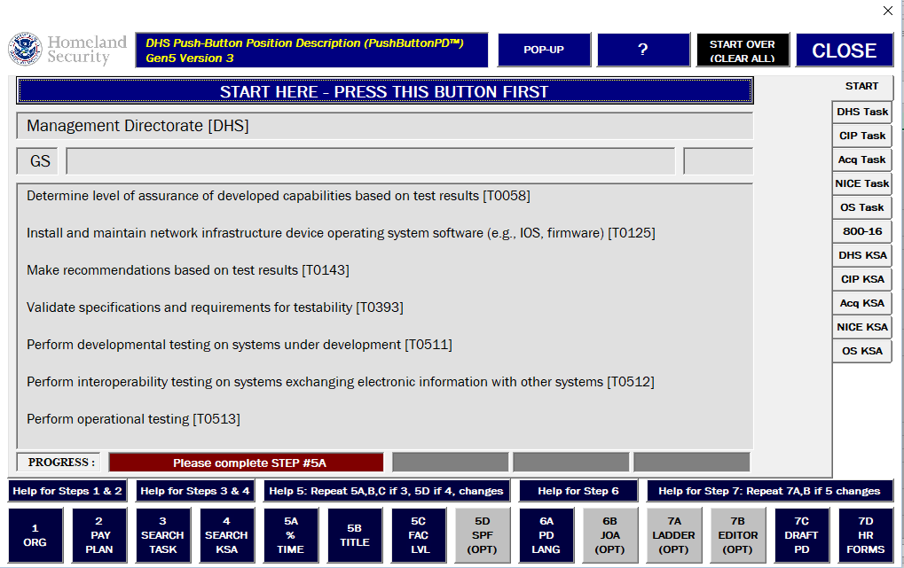
Step 1: Select an Organization

Slide 5
Step 2: Select a Pay Plan

Slide 6
Step 3: Select Tasks
METHOD B:
ADVANCED
TABS
METHOD A:
SEARCH

Slide 7
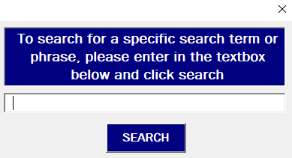
Method A: Search
WARNING: this is the slowest feature of the tool.
RECOMMENDATION: only use for exact terms when you cannot find the appropriate language via Method B.
The terms are exact / case sensitive.
Wildcards are not recognized.

Slide 8
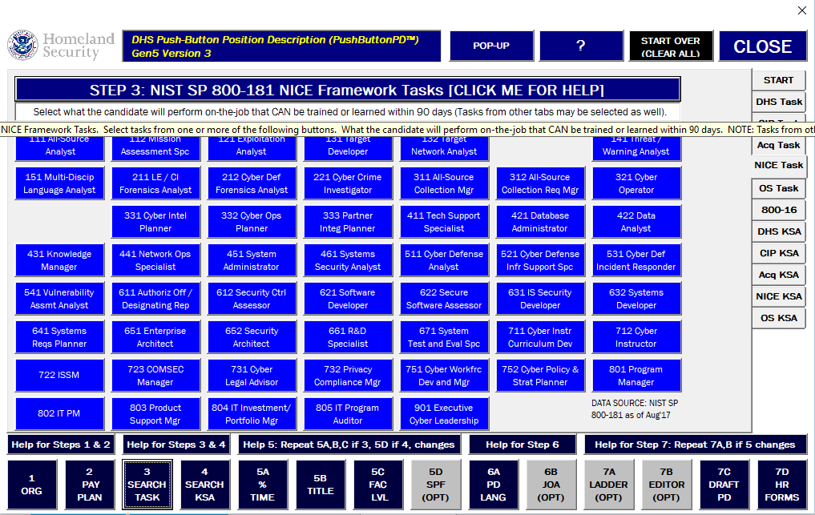
Method B: Tabs
Use the tabs along the right hand side to select between different topic areas.
For Tasks: select what the person should do on the job that can be learned or trained within 90-days.
For KSAs: select what should be on the person’s resume that qualifies them for this work that cannot be learned or trained within 90-days.

Slide 9
Step 4: Select Competencies & KSAs
METHOD B:
ADVANCED
TABS
METHOD A:
SEARCH

Slide 10
Step 5a: Select % of Time

Slide 11
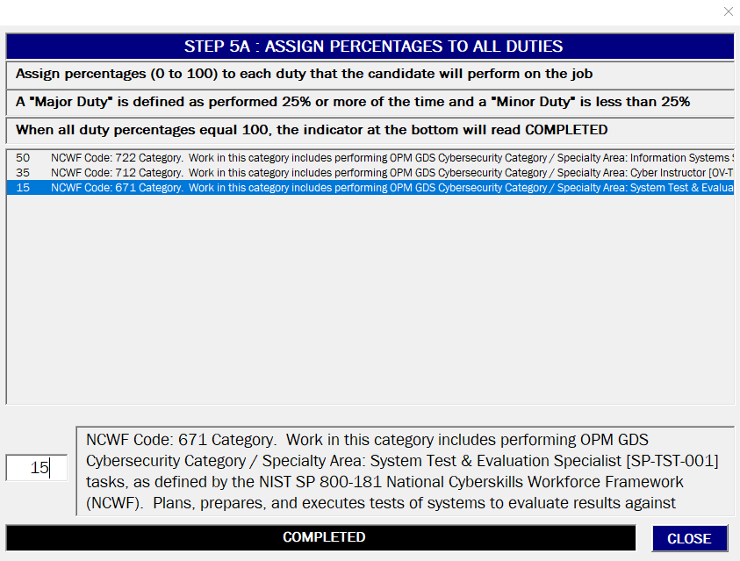
Select % of Time
Highlight the Major Duty.
Allocate the percentage of time for each Major Duty.
Ensure the percentage of time adds up to 100% (i.e. Completed)

Slide 12
Step 5b: Select Title

Slide 13
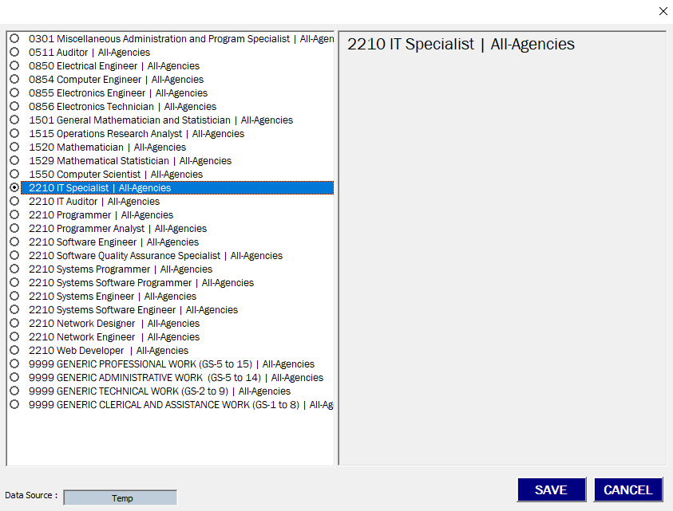
Step 5b: Select Title
Select an appropriate Occupational Series and Title for the position.

Slide 14
Step 5c: Select Factor Levels

Slide 15
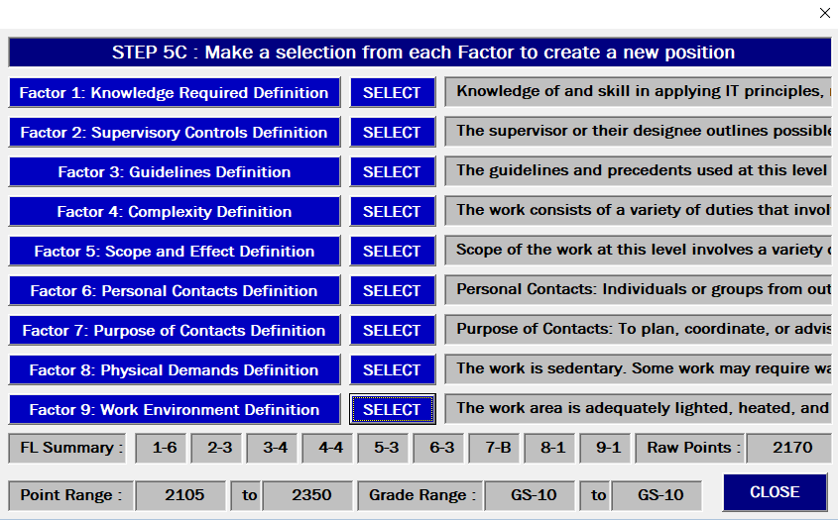
Select Factor Levels
Select the most appropriate verbiage that describes the position.
Ensure all Factor Levels have a response before proceeding.

Slide 16
Step 6a: Select Position Description Language

Slide 17
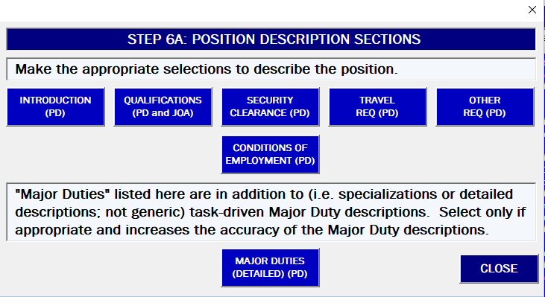
Select Position Description Language
Select appropriate language that describes requirements for the position.
Major Duties include work appropriate to specialized positions or teams; and other unique requirements.

Slide 18
Step 7c: Print Draft PD

Slide 19
Step 7d: Print HR Forms

Slide 20
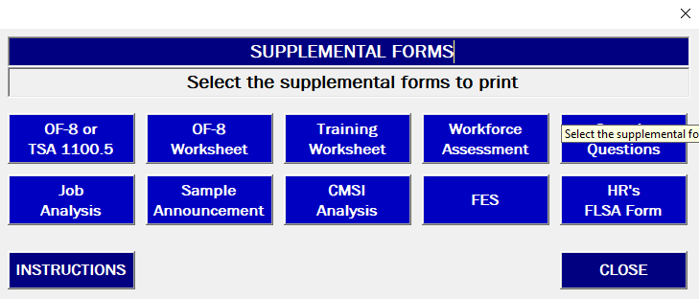
Print HR Forms
Print out the forms as directed by your servicing HR office.
Note that the OF-8 (and TSA 1100.5) will need to be downloaded or provided by your servicing HR office.

Slide 21
Advanced PD Generation
Steps 5d, 6b, 7a, 7b

Slide 22
Step 5d: Selective Placement Factor

Slide 23
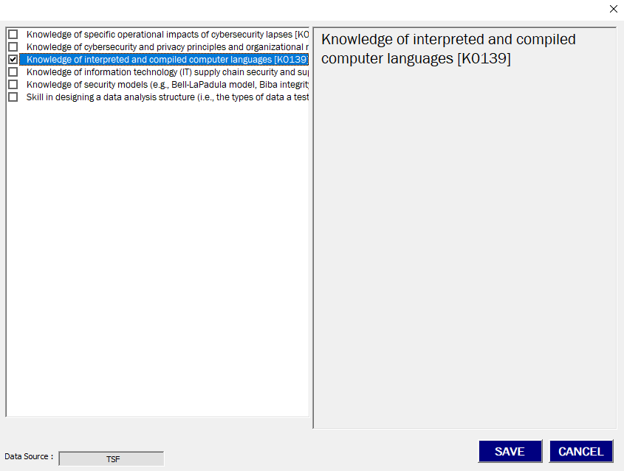
Selective Placement Factors
Displays the KSA’s Chosen by the User.
User selects one (or two) that meet the following criteria:

Slide 24
Step 6b: Job Opportunity Announcement

Slide 25
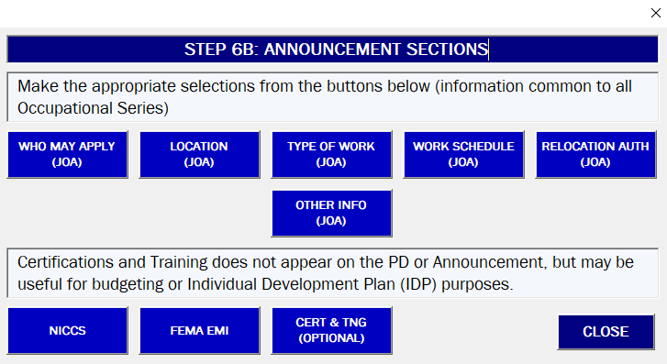
Job Opportunity Announcement
Select appropriate language that describes requirements for the position that will appear in the announcement.
When populated, the Certification and Training section may be used to identify position training requirements. This information does not print in the Position Description, but on a separate sheet.

Slide 26
Step 7a: Ladder

Slide 27
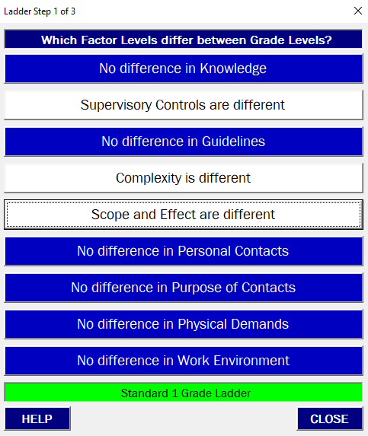
Ladder
Generate the upper-level employee position.
Select the differences in Factor Levels between the upper and lower grade positions.
Ensure the indicator is GREEN.
In the next screens, select the Tasks and Competencies that belong to the higher or lower grade as appropriate.
Default is the Task / Competency applies to both grades equally.
Output in 7C will automatically adjust.

Slide 28
Step 7b: Editor

Slide 29
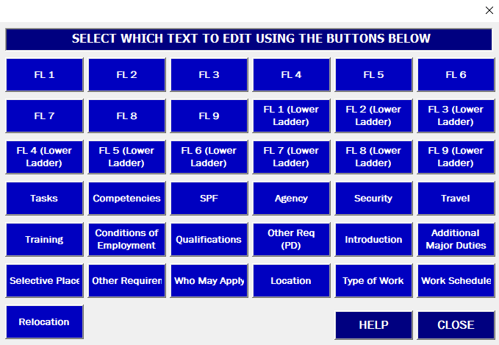
Editor
Select the language to edit.
Note that the editor feature is exceptionally rudimentary at this time.
Recommend typing in Word or Notepad and pasting in; or just edit the output directly.

